Slide 1


Capstone Project – Weather Analysis

Slide 2

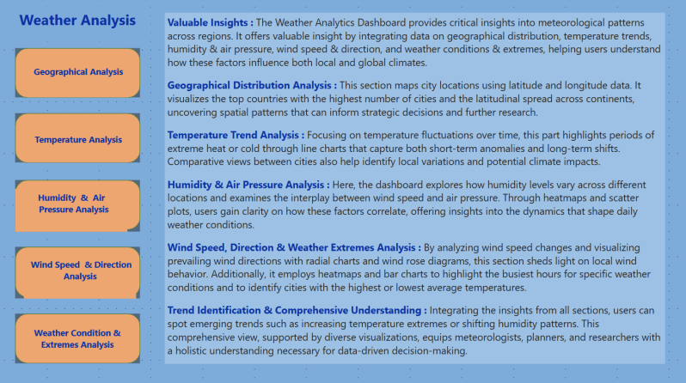




Slide 3
Objective: the objective of this project is to create a comprehensive power BI dashboard utilizing the weather data database. The dashboard aims to provide valuable insights into weather trends, temperature variations, humidity levels, wind patterns, and extreme weather conditions. This will enable data-driven decision-making for climate monitoring, forecasting, and strategic planning.
Analysis scope: the analysis will focus on various aspects of weather patterns, including temperature trends over time, humidity fluctuations, wind speed and direction analysis, and the impact of weather conditions on different regions. It will encompass historical weather data, geographical distribution of weather attributes, and correlations between different climate factors across multiple cities and countries.
Goal: the primary goal of this power bi dashboard is to offer a holistic view of weather trends and climate patterns. It will provide actionable insights to help meteorologists, researchers, and decision-makers optimize weather forecasting, analyze seasonal variations, identify extreme weather events, and improve overall weather-related strategies.

Slide 4
Report & presentation: the report and presentation will showcase the power bi dashboard’s findings, explaining key weather trends and patterns. It will include visualizations such as geographical maps, time-series charts, heatmaps, and scatter plots to illustrate climate behaviors effectively. The presentation will highlight significant insights, methodologies used, and recommendations based on the analysis.
Insights & recommendations : identification of cities with the highest and lowest average temperatures for better climate awareness. Recognition of seasonal variations in humidity and air pressure for weather forecasting improvements. Understanding wind speed and direction patterns for transportation and energy sector applications. Detection of extreme weather conditions and their impact to aid disaster preparedness.
The power bi dashboard will serve as a powerful tool for analyzing historical and real-time weather data, facilitating informed decision-making for climate research, urban planning, and disaster management.

Slide 5
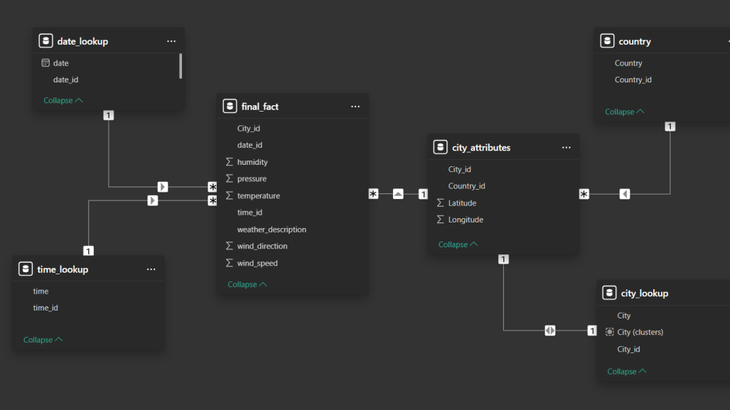
ER Diagram

Slide 6

Power BI Problem Statements

Slide 7
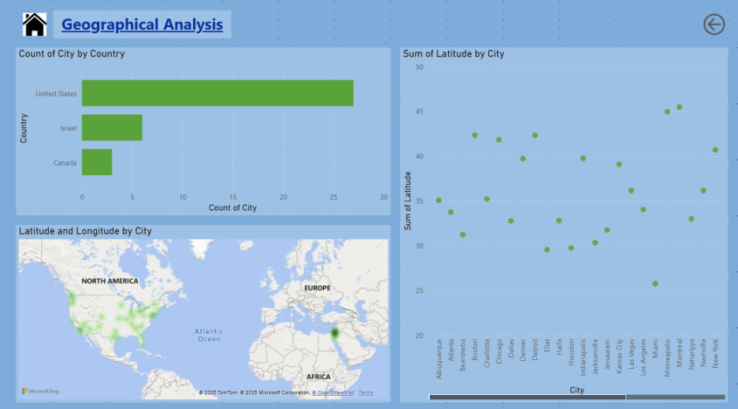

Slide 8
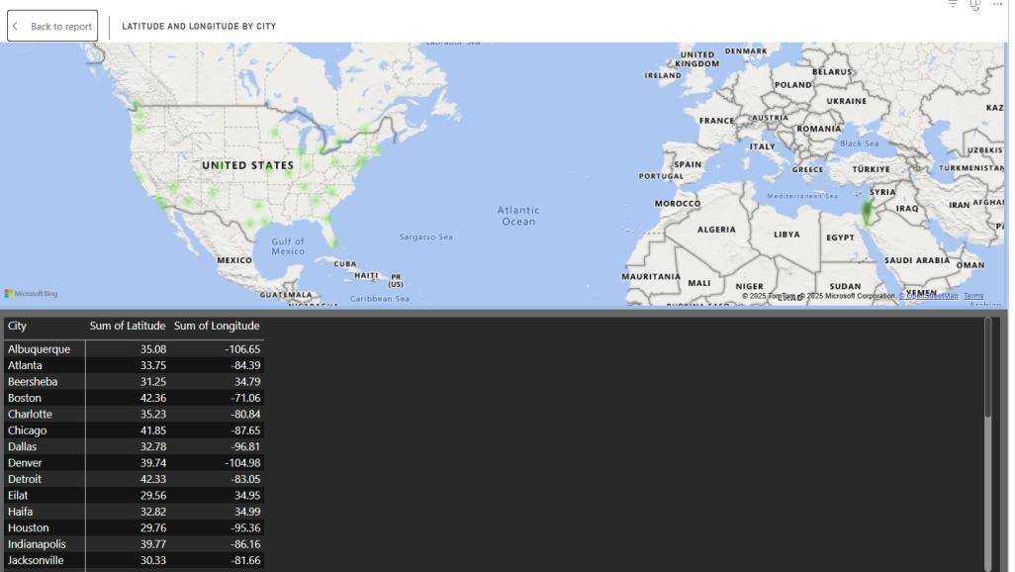
Can you create a geographical map in power BI showing the distribution of cities in the dataset based on their latitude and longitude?
Cities are more densely distributed in specific regions, often around major economic hubs or favorable climatic zones.
The map helps identify underrepresented areas, which can be useful for urban development and infrastructure planning.

Slide 9
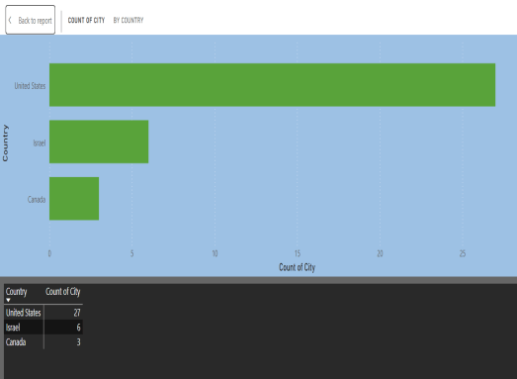
In power BI, can you create a bar chart representing the top 10 countries with the highest number of cities in the dataset?
Conclusion :The highest number of cities is found in countries with large land areas or high urbanization rates. This analysis provides insights into population density and regional urban planning trends.

Slide 10
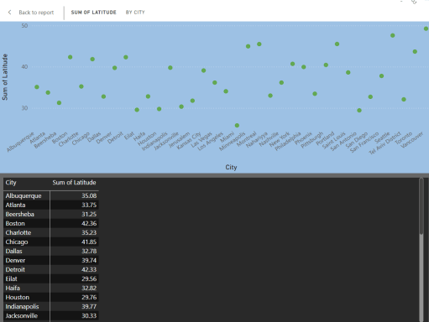
How does the distribution of cities in terms of latitude vary across different continents? Create a scatter plot in power BI to illustrate this.
Conclusion : Latitude influences climate, with cities closer to the equator experiencing warmer temperatures and those farther experiencing colder climates. Differences in latitude distribution highlight the varying population settlements across continents.

Slide 11
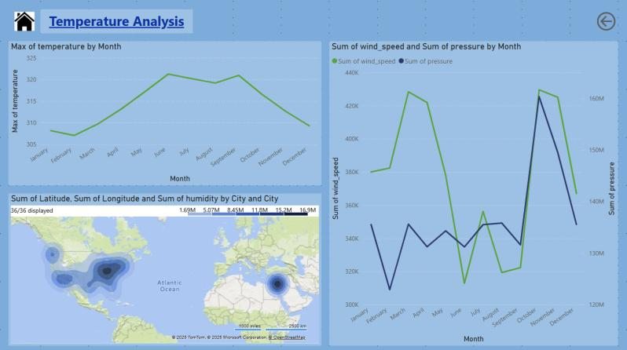

Slide 12
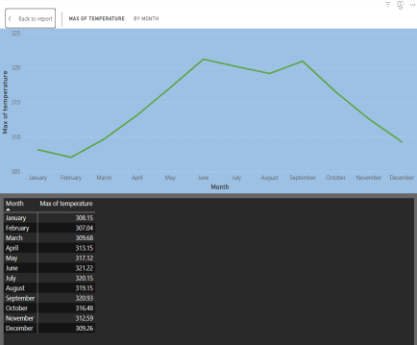
Create a line chart in Power BI to display the temperature trends over time for a selected city. Highlight extreme temperature events.
Conclusion: Temperature trends reveal seasonal variations and long-term climate changes in the selected city. Extreme temperature events, such as heatwaves or cold spells, can be identified for better forecasting and preparedness.

Slide 13
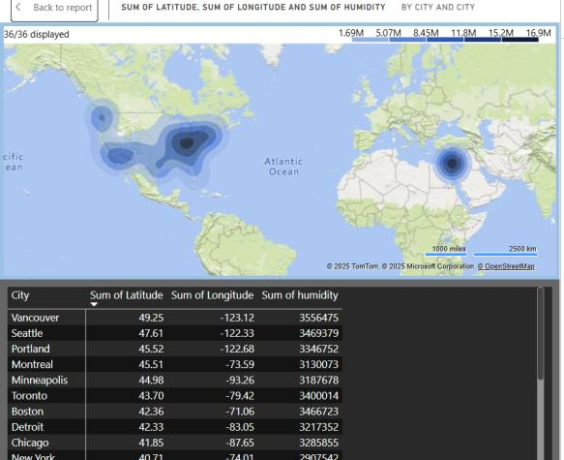
How does humidity vary across different cities? Generate a heatmap in Power BI to visualize this variation.
Conclusion: Cities near water bodies tend to have higher humidity levels, while inland regions may experience drier conditions. The visualization helps in understanding the impact of humidity on weather patterns and human comfort.

Slide 14
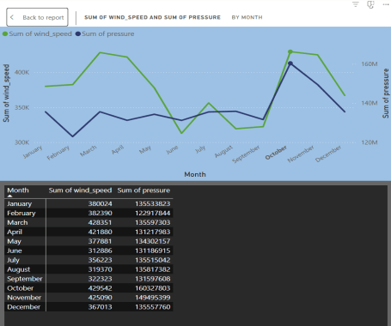
Can you create a time-series chart in Power BI showing the relationship between wind speed and air pressure for a specific city?
Conclusion: A strong inverse relationship often exists between wind speed and air pressure, especially during storms or cyclones. This analysis helps predict severe weather conditions and assess atmospheric stability.

Slide 15
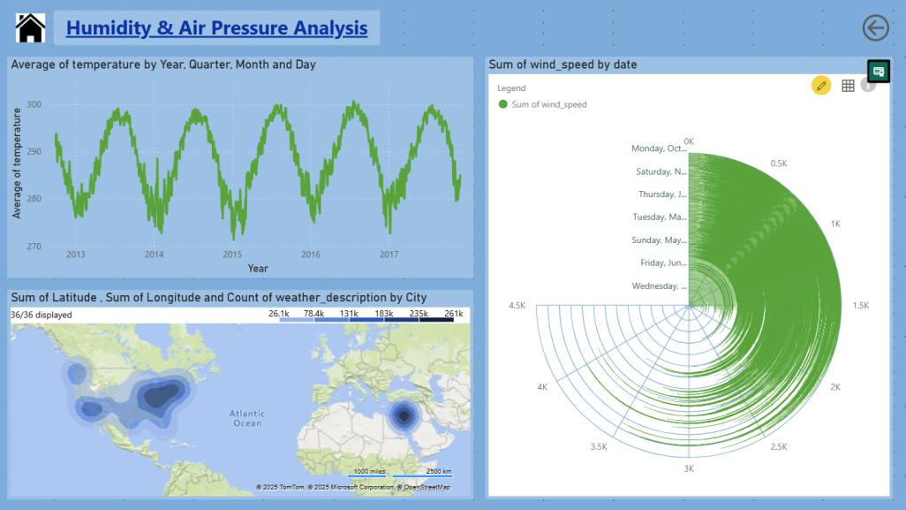

Slide 16
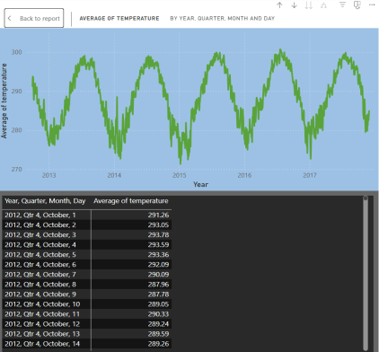
Create a time-series line chart in Power BI to show the overall temperature trends over the entire dataset.
Conclusion: Long-term temperature trends indicate global warming or regional climatic shifts. Anomalies in temperature can help identify unusual weather patterns and their causes.

Slide 17
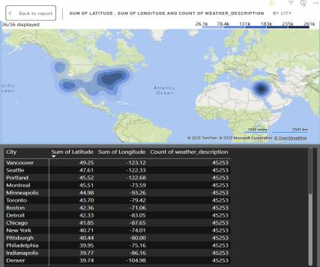
Can you create a heatmap in Power BI to visualize the busiest hours for specific weather conditions (e.g., "clear sky," "rainy")?
Conclusion: Certain weather conditions, such as "rainy" or "clear sky," tend to occur more frequently during specific times of the day. This analysis can help in transportation, event planning, and energy consumption predictions.

Slide 18
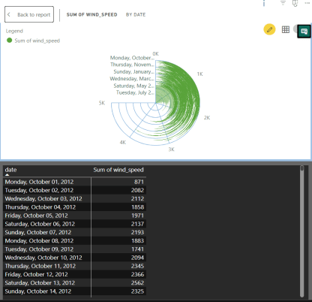
How does the wind speed change over the course of a day? Create a radial chart in Power BI to represent this.
Conclusion: Wind speed typically fluctuates, with peaks occurring during midday due to temperature differences. This pattern helps in wind energy generation and aviation planning.

Slide 19
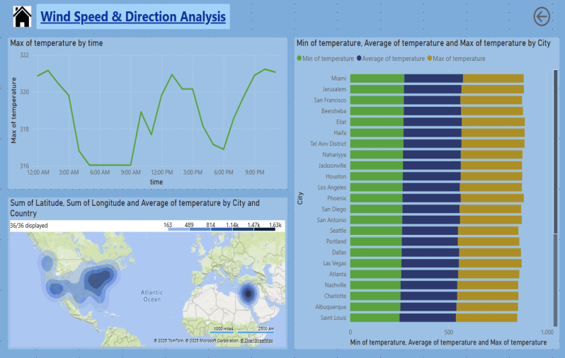

Slide 20
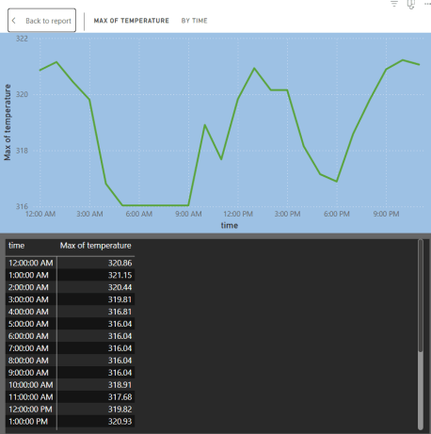
Create a Power BI chart comparing the temperature variations between two selected cities over a specific timeframe.
Conclusion: Cities with different geographic locations exhibit distinct temperature trends influenced by altitude, proximity to water bodies, and latitude. Seasonal variations between cities provide insights into climatic differences and their impact on daily life.

Slide 21
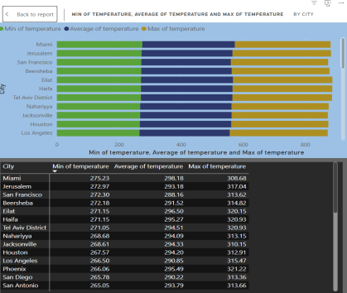
Create a bar chart in Power BI to highlight cities with the highest and lowest average temperatures in the dataset.
Conclusion: Cities with extreme temperatures are often influenced by their altitude, latitude, or desert/mountainous conditions. Identifying such cities helps in planning infrastructure, energy needs, and public health strategies.

Slide 22
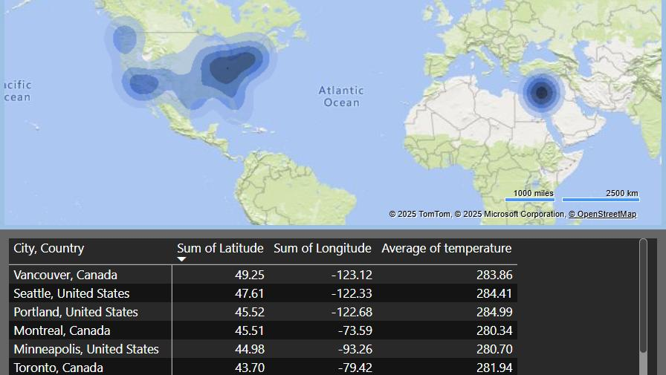
Can you build a heatmap in Power BI to show the temperature ranges for cities across different countries?
Conclusion: Temperature variations highlight climatic differences among countries, influencing agriculture, tourism, and living conditions. Extreme temperature zones can be identified for further study on adaptation and mitigation strategies.

Slide 23
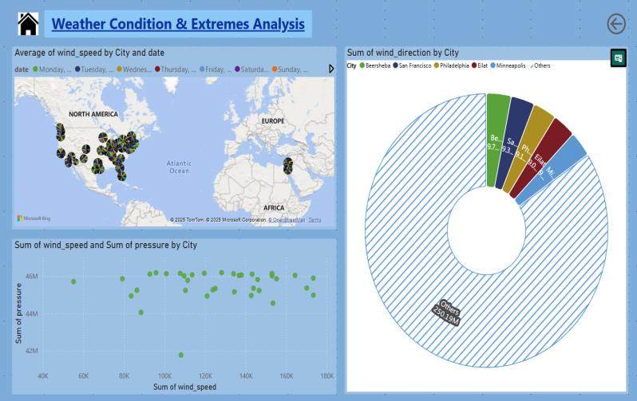

Slide 24
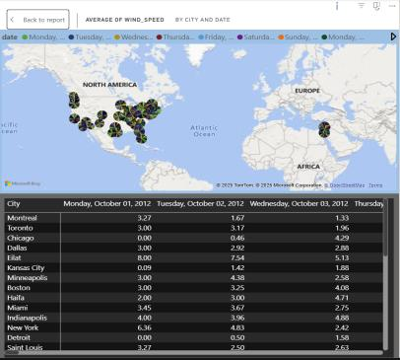
Can you generate a Power BI heatmap illustrating the average wind speeds across cities for different months of the year?
Conclusion: Seasonal wind speed variations influence weather changes, monsoon patterns, and storm formations. The data is useful for planning outdoor activities, renewable energy projects, and disaster preparedness.

Slide 25
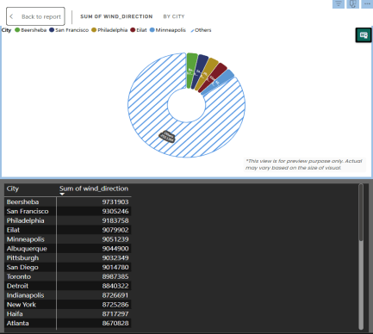
Create a wind rose chart in Power BI to visualize the prevailing wind directions for a selected city.
Conclusion: Wind patterns indicate dominant seasonal winds, which affect weather conditions and air quality. Understanding wind direction is crucial for aviation, wind energy production, and pollution control.

Slide 26
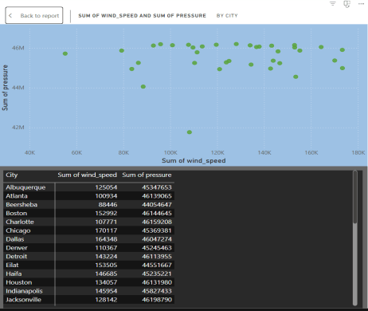
Create a Power BI scatter plot to show the relationship between wind speed and air pressure for a specific city.
Conclusion: Lower air pressure often correlates with stronger winds, indicating stormy conditions. The scatter plot helps in predicting and monitoring extreme weather events like hurricanes and cyclones.

Slide 27
EDA Problem Statements

Slide 28
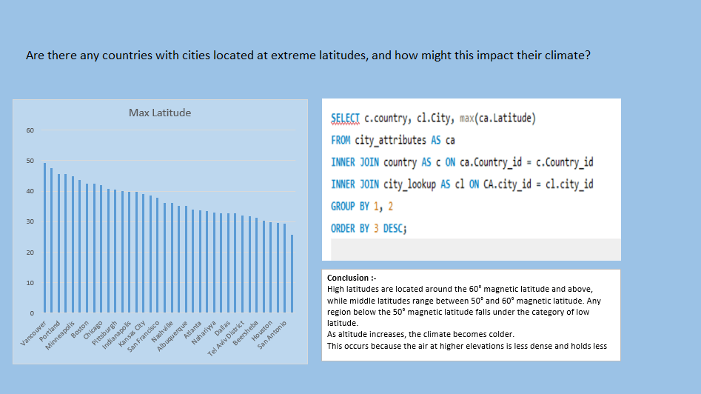

Slide 29
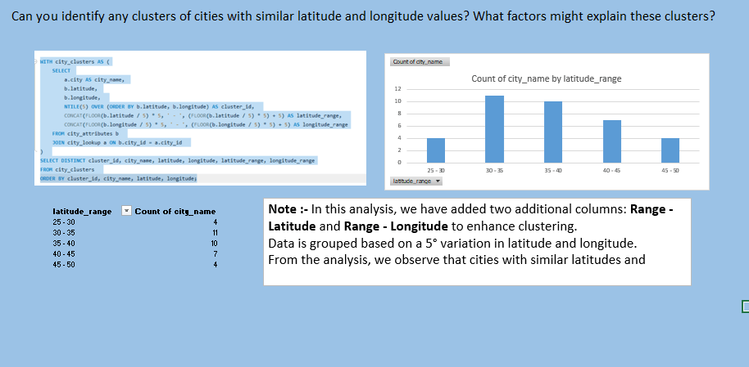

Slide 30
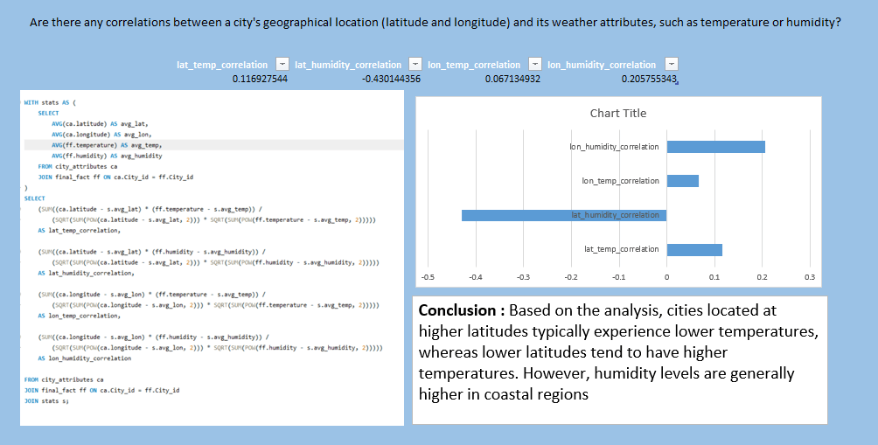

Slide 31
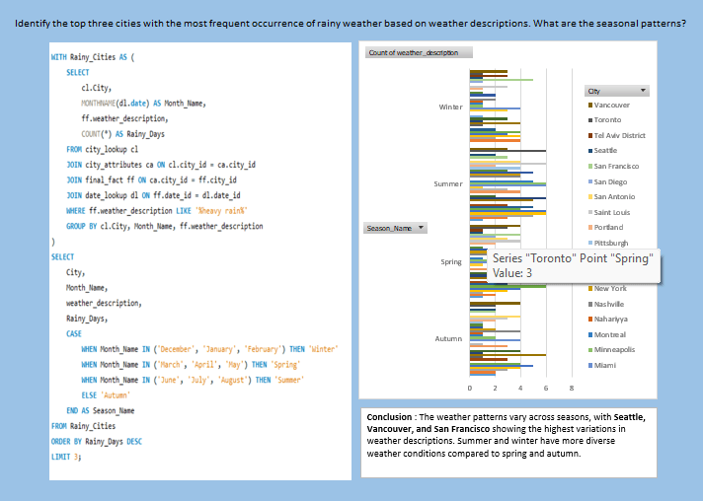

Slide 32
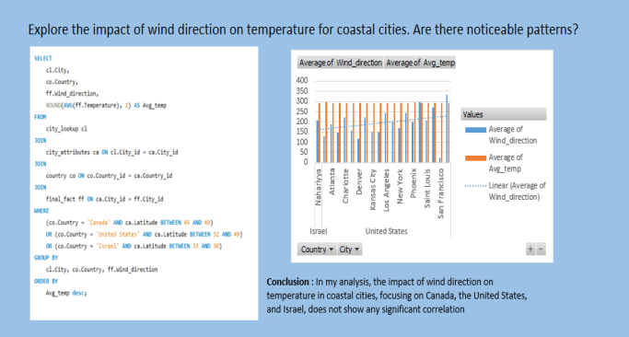

Slide 33
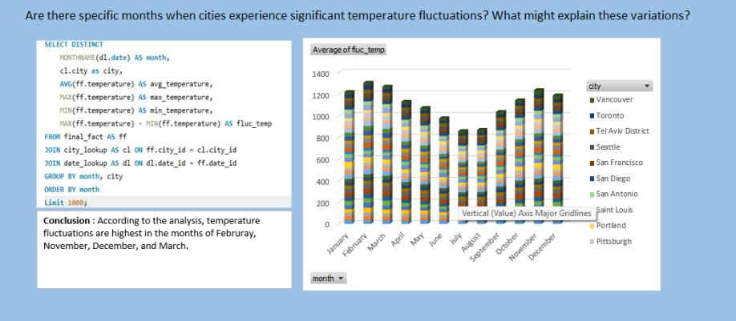

Slide 34
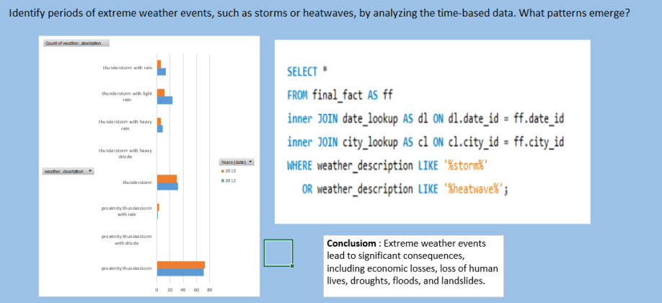

Slide 35
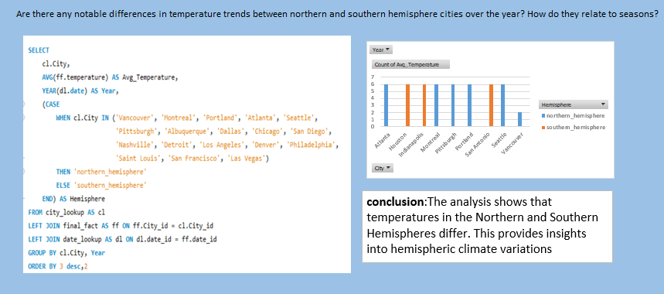

Slide 36
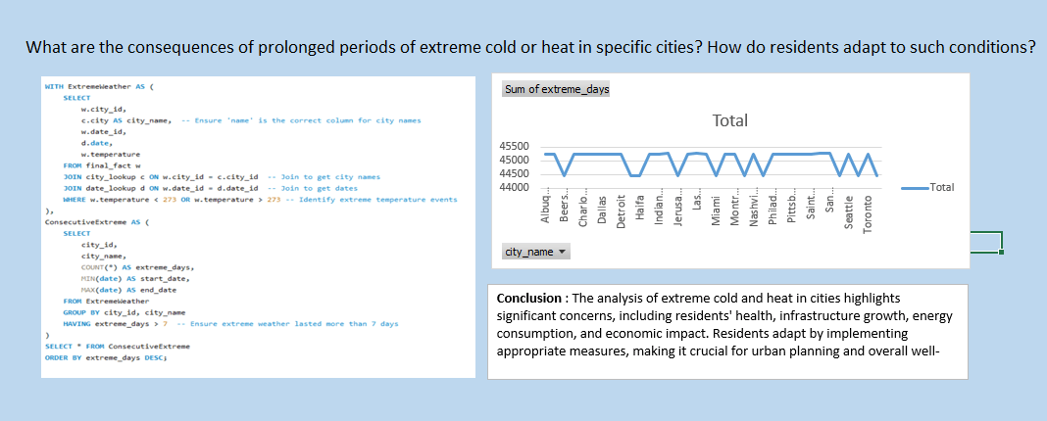

Slide 37
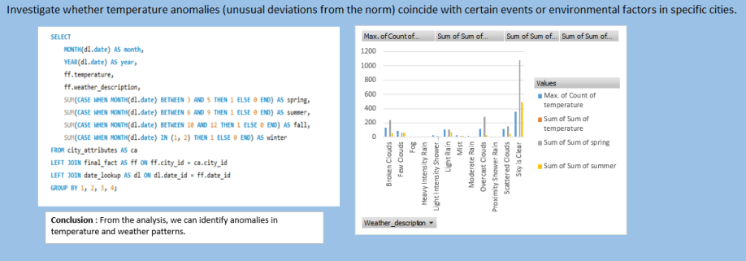

Slide 38
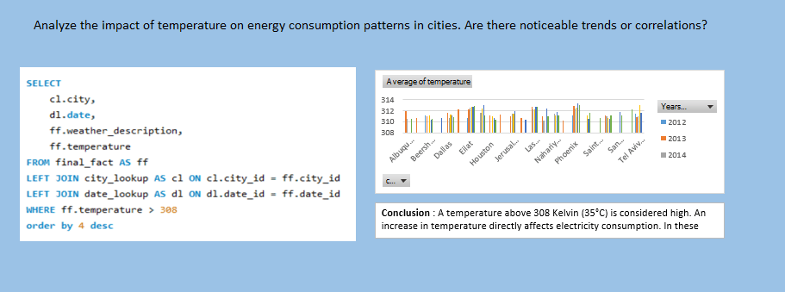

Slide 39
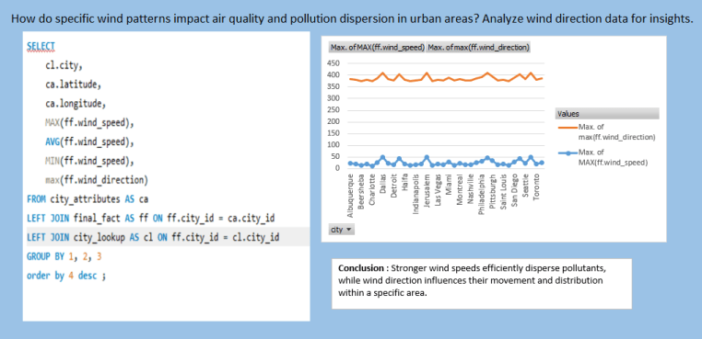

Slide 40
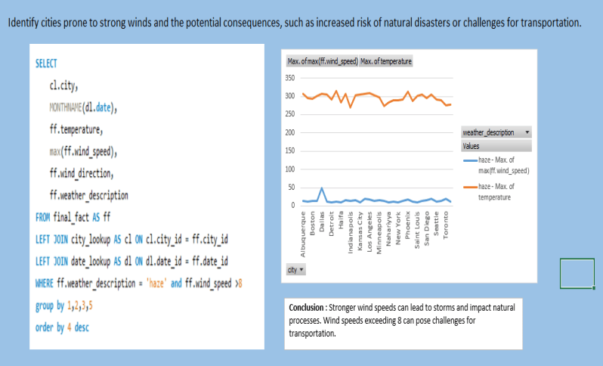

Slide 41
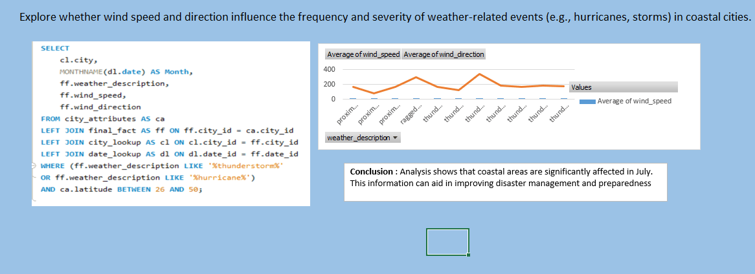

Slide 42
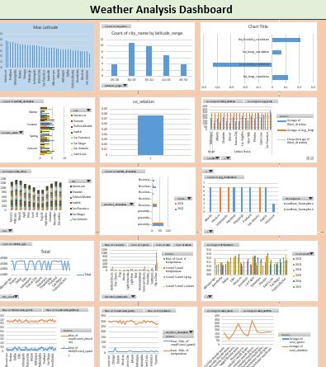
Conclusion : I have just created new sheet in excel and copy all the chart and then paste it on a single sheet make a Dashboard and finally it look this.

Slide 43

THANK YOU

